Slide 1
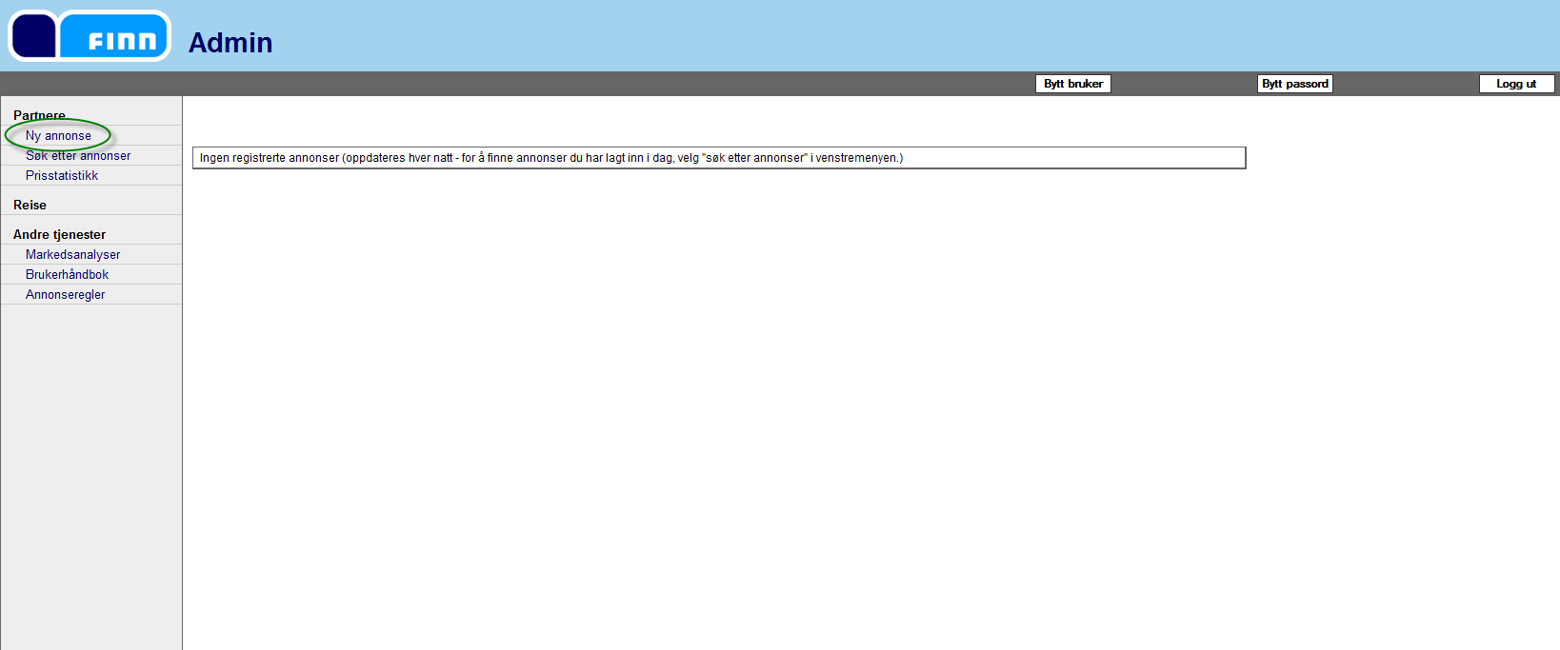
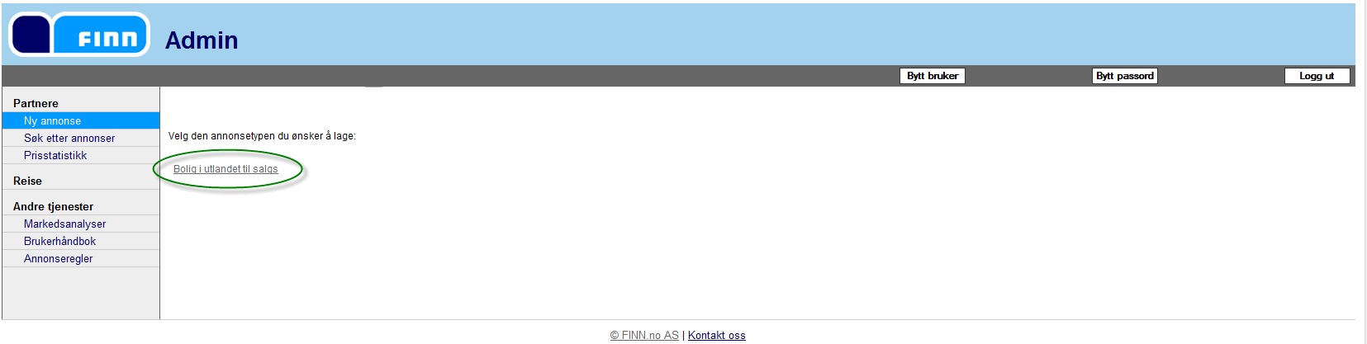
1. Choose Ny annonse – New Ad
2. Choose Bolig i utlandet til salgs – Real estate for sale abroad

Slide 2
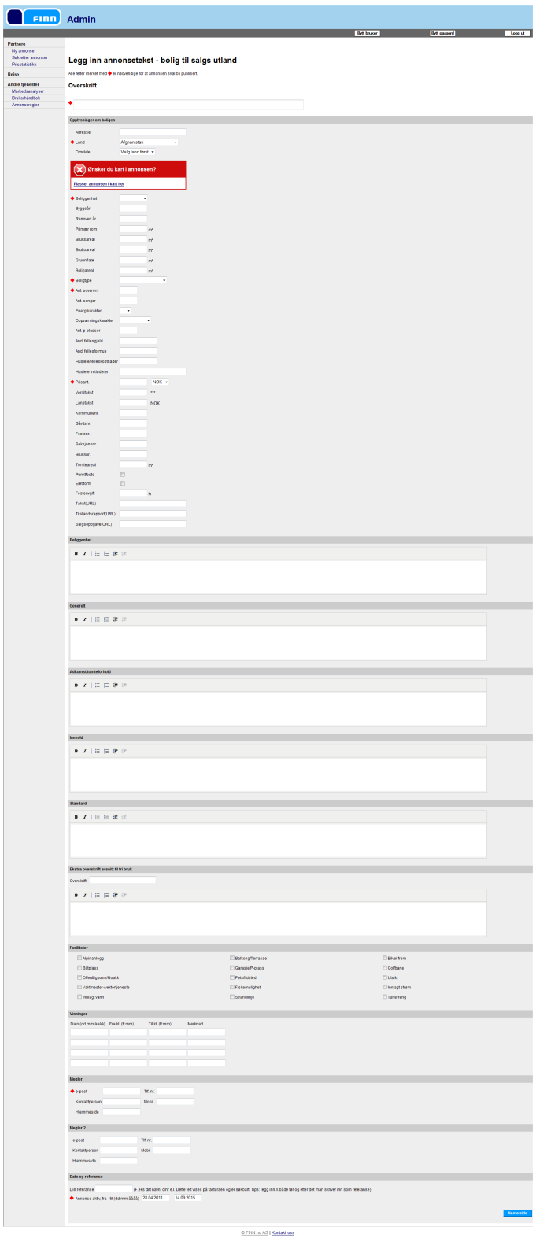

3. Fill in information regarding the property.
Fields marked with blue star is required fields
Fields marked with is common fields to fill out
I’ve split this page into svereal sections, so please see the next pages

Slide 3
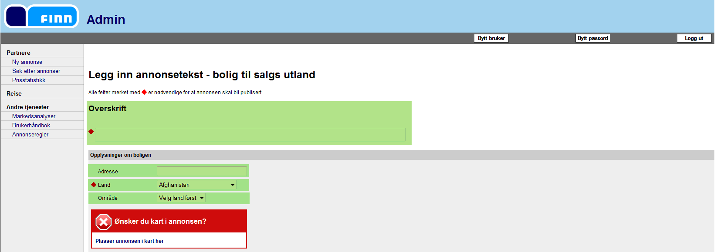
1.
2.
3.
4.
5.
1. Overskrift – Heading for the ad
2. Adresse – Adress
3. Land – Country, choose country
4. Område – Area, choose which area in the country
5. If you want map in the ad, please choose Plasser annonsen i kart her – place the ad in map

Slide 4
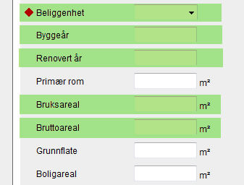

På fjellet – On the mountain
Ved sjøen – Bye the sea
Innlandet – Inland
Beliggenhet – means Location
Byggeår – Building year
Renovert år – Year of renovation
Bruksareal – Floor Space
Bruttoareal – Gross area
Primær rom, Grunnflate and Boligareal is for Norweagian properties.

Slide 5
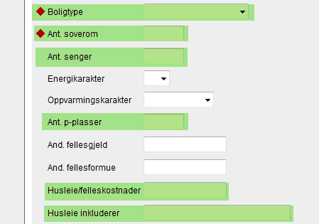
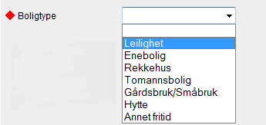
Leilighet – Flat
Enebolig – House
Rekkehus – Terraced house
Gårdsbruk – Farm
Hytte – Cottage
Boligtype – Means house type
Ant. Soverom – Number of bedrooms
Ant. Senger – Number of beds
Ant. p-plasser – Number of parkingspots
Husleie/felleskostnader – Rent/ common costs
Husleie inkluderer – Rent includes
Energikarakter, Oppvarmingskarakter, And. Fellesgjeld and And.fellesformue is for Norwegian properties

Slide 6
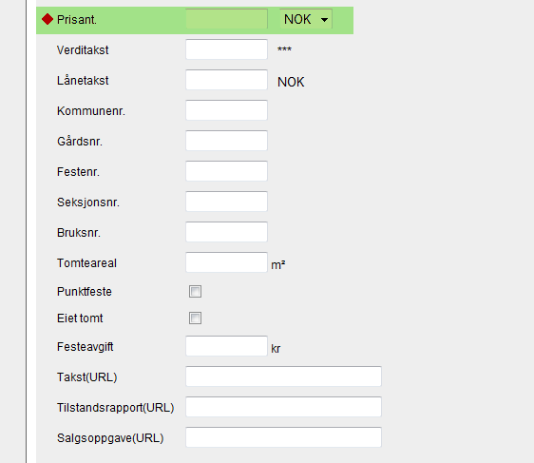
Prisant. – Prise indication (remeber to choose currancy)
The rest is for norwegian properties

Slide 7
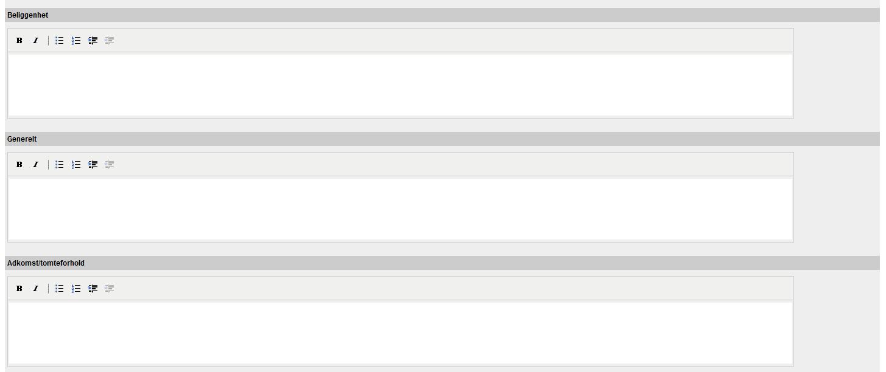
Beliggenhet – Location of the property
Generelt – General information about the property
Adkomst/ tomteforhold – Acess to the property and plot conditions

Slide 8
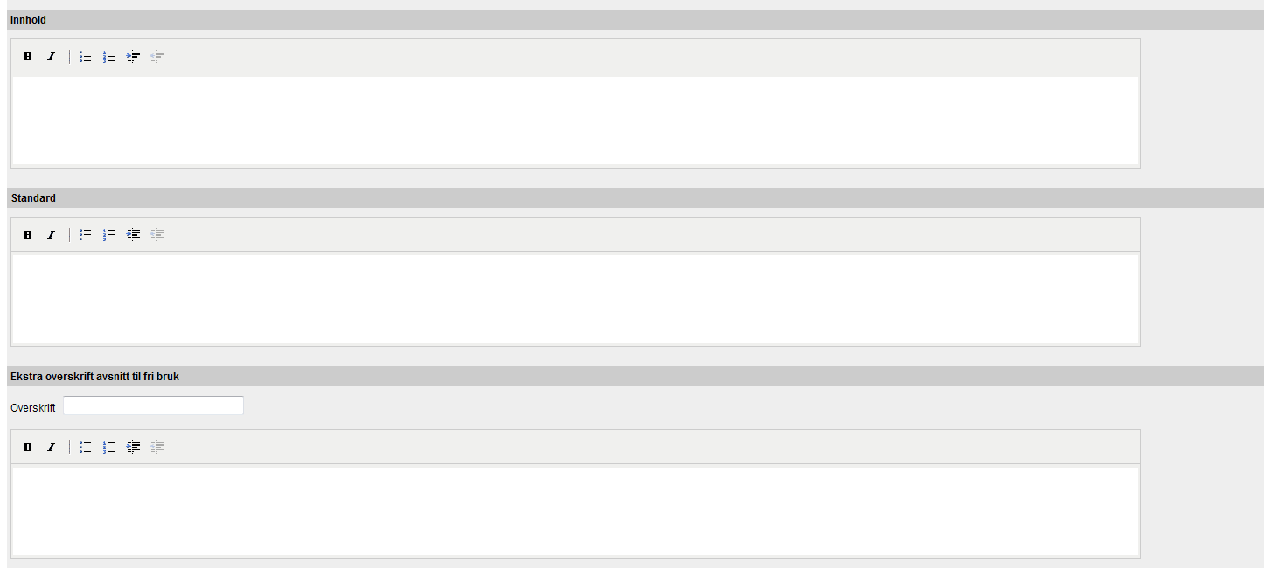
Innhold – Content of the house/property
Standard – Standard of the house/property
Ekstra overskrift avsnitt til fri bruk – Extra heading and section free to use
Fill in overskrift – heading, and text.

Slide 9
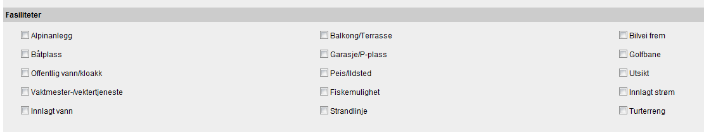
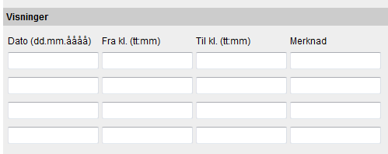
Aplinanlegg - Skiresort
Båtplass - Harbour for own boat
Offentlig vann- Public water and sewer
Vaktmester - Caretaker/Janitor
Innlagt vann - Indoor plumming
Balkong/Terrasse – Balcony/Terrace
Garasje/P-plass – Garage/Parkingspot
Peis/Ildsted – Fireplace
Fiskemulighet – Possibility for fishing
Strandlinje – Beachline
Bilvei frem – Road to house
Golfbane – Golfcourse
Utsikt – View
Innlagt strøm – Indoor electric
Turterreng – Possibility for hiking
Visninger – Showing of the property
Dato (dd.mm.åååå) – Date (dd.mm.yyyy)
Fra kl. (tt.mm) – From clock (tt.mm)
Til kl. (tt.mm) – To clock (tt.mm)
Merknad – Note

Slide 10
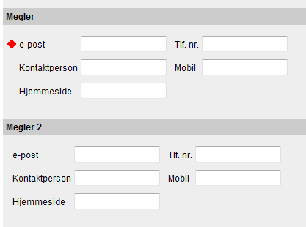
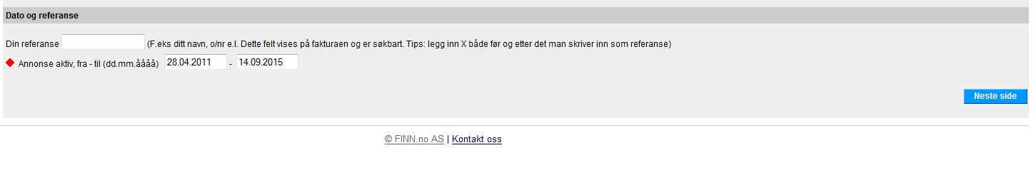
Megler – Broker/seller
Kontaktperson – Contactperson name
Hjemmeside – Homepage
Tlf. nr – Phone
Mobil – Mobile
Megler 2 – If you want two contactpersons in the ad, pleas fill in this as well.
Din referanse – Your referance, if you want to have a special referance on the invoice for this property
Annonse aktiv fra-til (dd.mm.åååå) – Ad active from-to date (dd.mm.yyyy)
To continue, choose Neste side – Next page

Slide 11
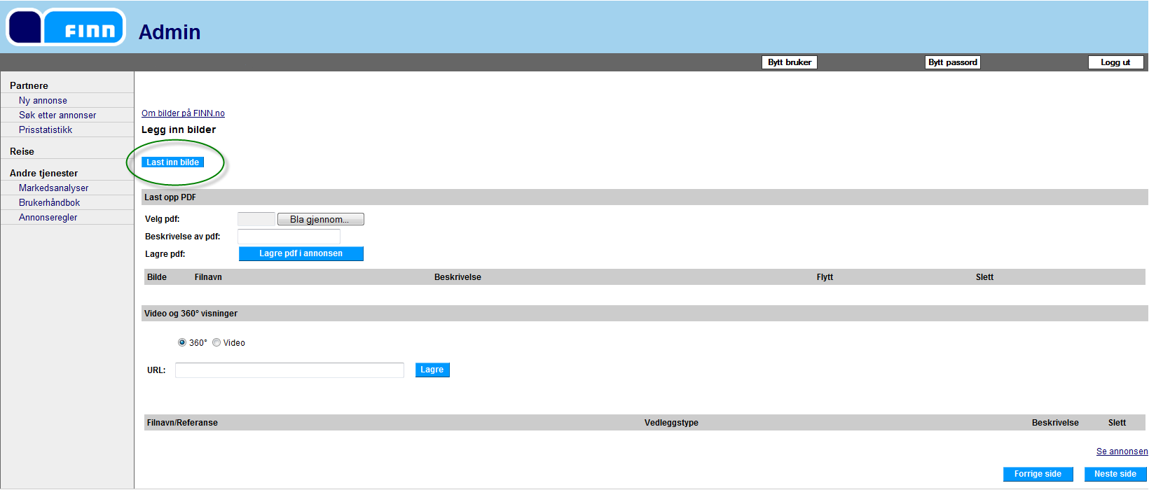
4. Upload pictures
Choose Last inn bilder – Upload photos
If you have any PDF-documents you want to publish in the ad, pleas choose Lagre pdf i annonsen – save pdf in the ad
If you want video or 360 pictures in the ad, chose this and fill in link to where the video/pdt is published and choose Lagre - Save
Se annonsen – See the ad Forrige side – Previous page Neste side – Next page

Slide 12
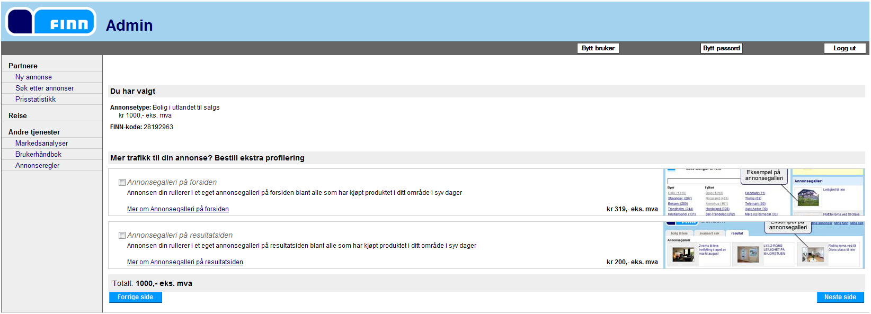
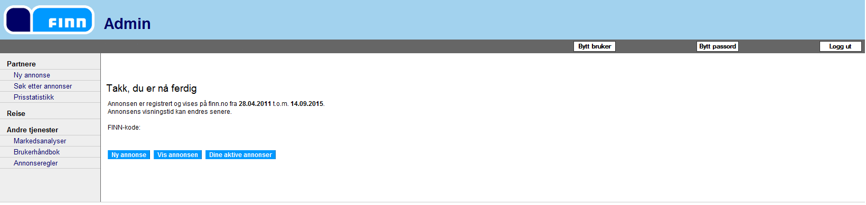
After uploading the pictures (and pdf/360 pictures) choose next page, and you’ll see this.
This is the last step before publishing.
Here you will see the cost for the ad, and the unique FINN-code for the ad.
To finish and publish, choose Neste side – Next page
Your are finished, and the ad will be active within short time

